Slide 1

Setting Technology Standards Campus Wide
Barrett Ford
Client Support Specialist
Iowa State University

Slide 2
A Little About Me
Originally from Minnesota
Technology Coordinator for Zumbro Education District
I have been at ISU for 5 years
Department of Residence
Client Support Specialist

Slide 3
A Little About ISU
As of September 12, 2019
  28,294 Undergraduates
8 colleges on campus
  Agriculture and Life Science
  Business
  Design
  Engineering
  Human Sciences
  Liberal Arts and Sciences
  Veterinary Medicine
  Interdepartmental and Undeclared

Slide 4
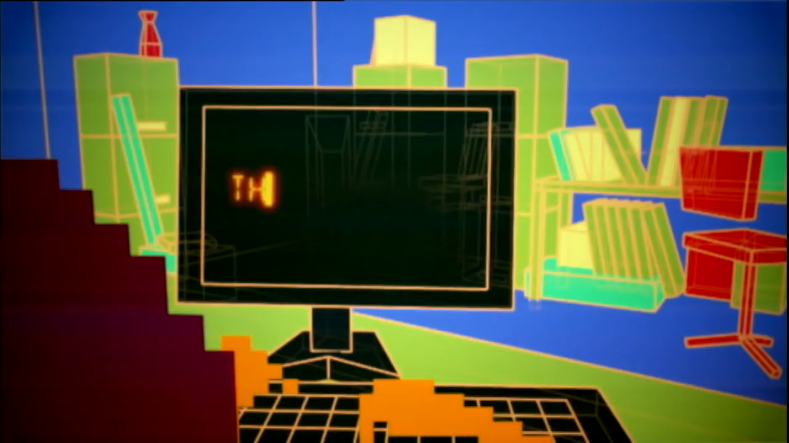
The Problem

Slide 5
The First Meeting
The heads of the Central IT gathered key groups together to form a diverse group to gain input.
  ITS, Agricultural and Life Sciences, Dept. of Residence, Classroom Services, Human Sciences, Extension IT, Vet. Med, Animal Sciences, Library, Design, Food Sciences, Liberal Arts and Sciences.

Slide 6
Beginning to Right the Ship
Central IT leadership contacted satellite groups.
Previous standards were from 2011.
Created Box Drive to keep notes and follow along meetings.
A couple colleges had their own standards.
  Extension IT
  Biology IT
Research

Slide 7
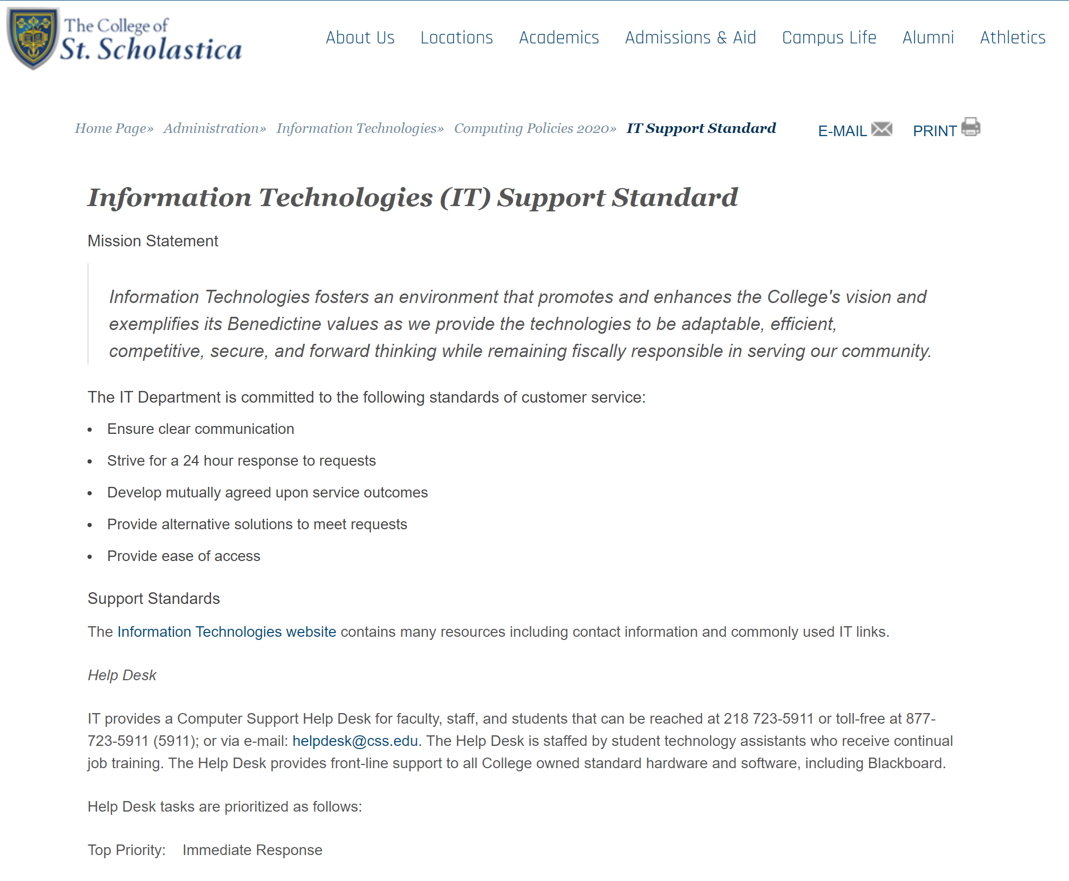
Research From Other Universities
The College of St. Scholastica

Slide 8
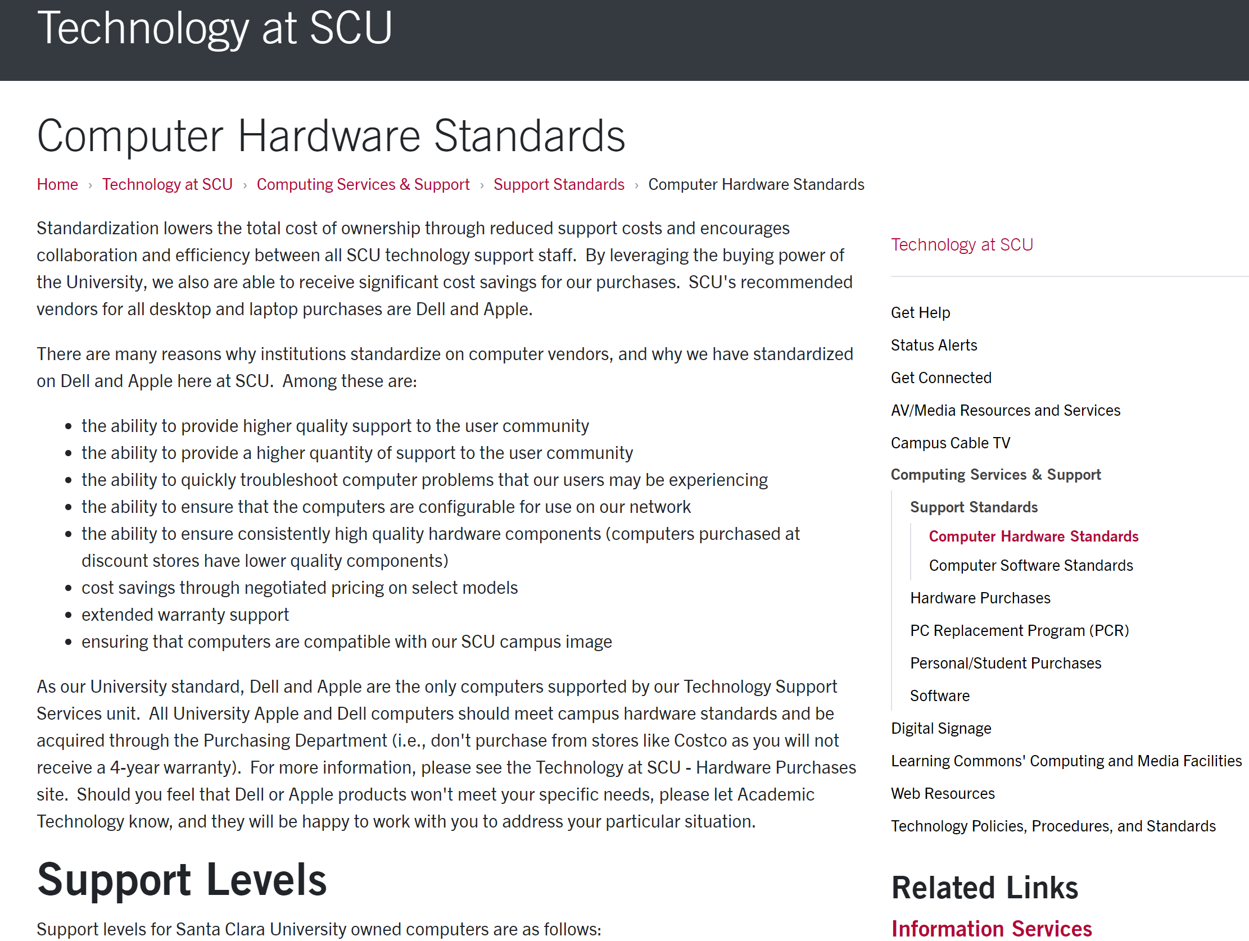
Research From Other Universities
University of Santa Clara

Slide 9
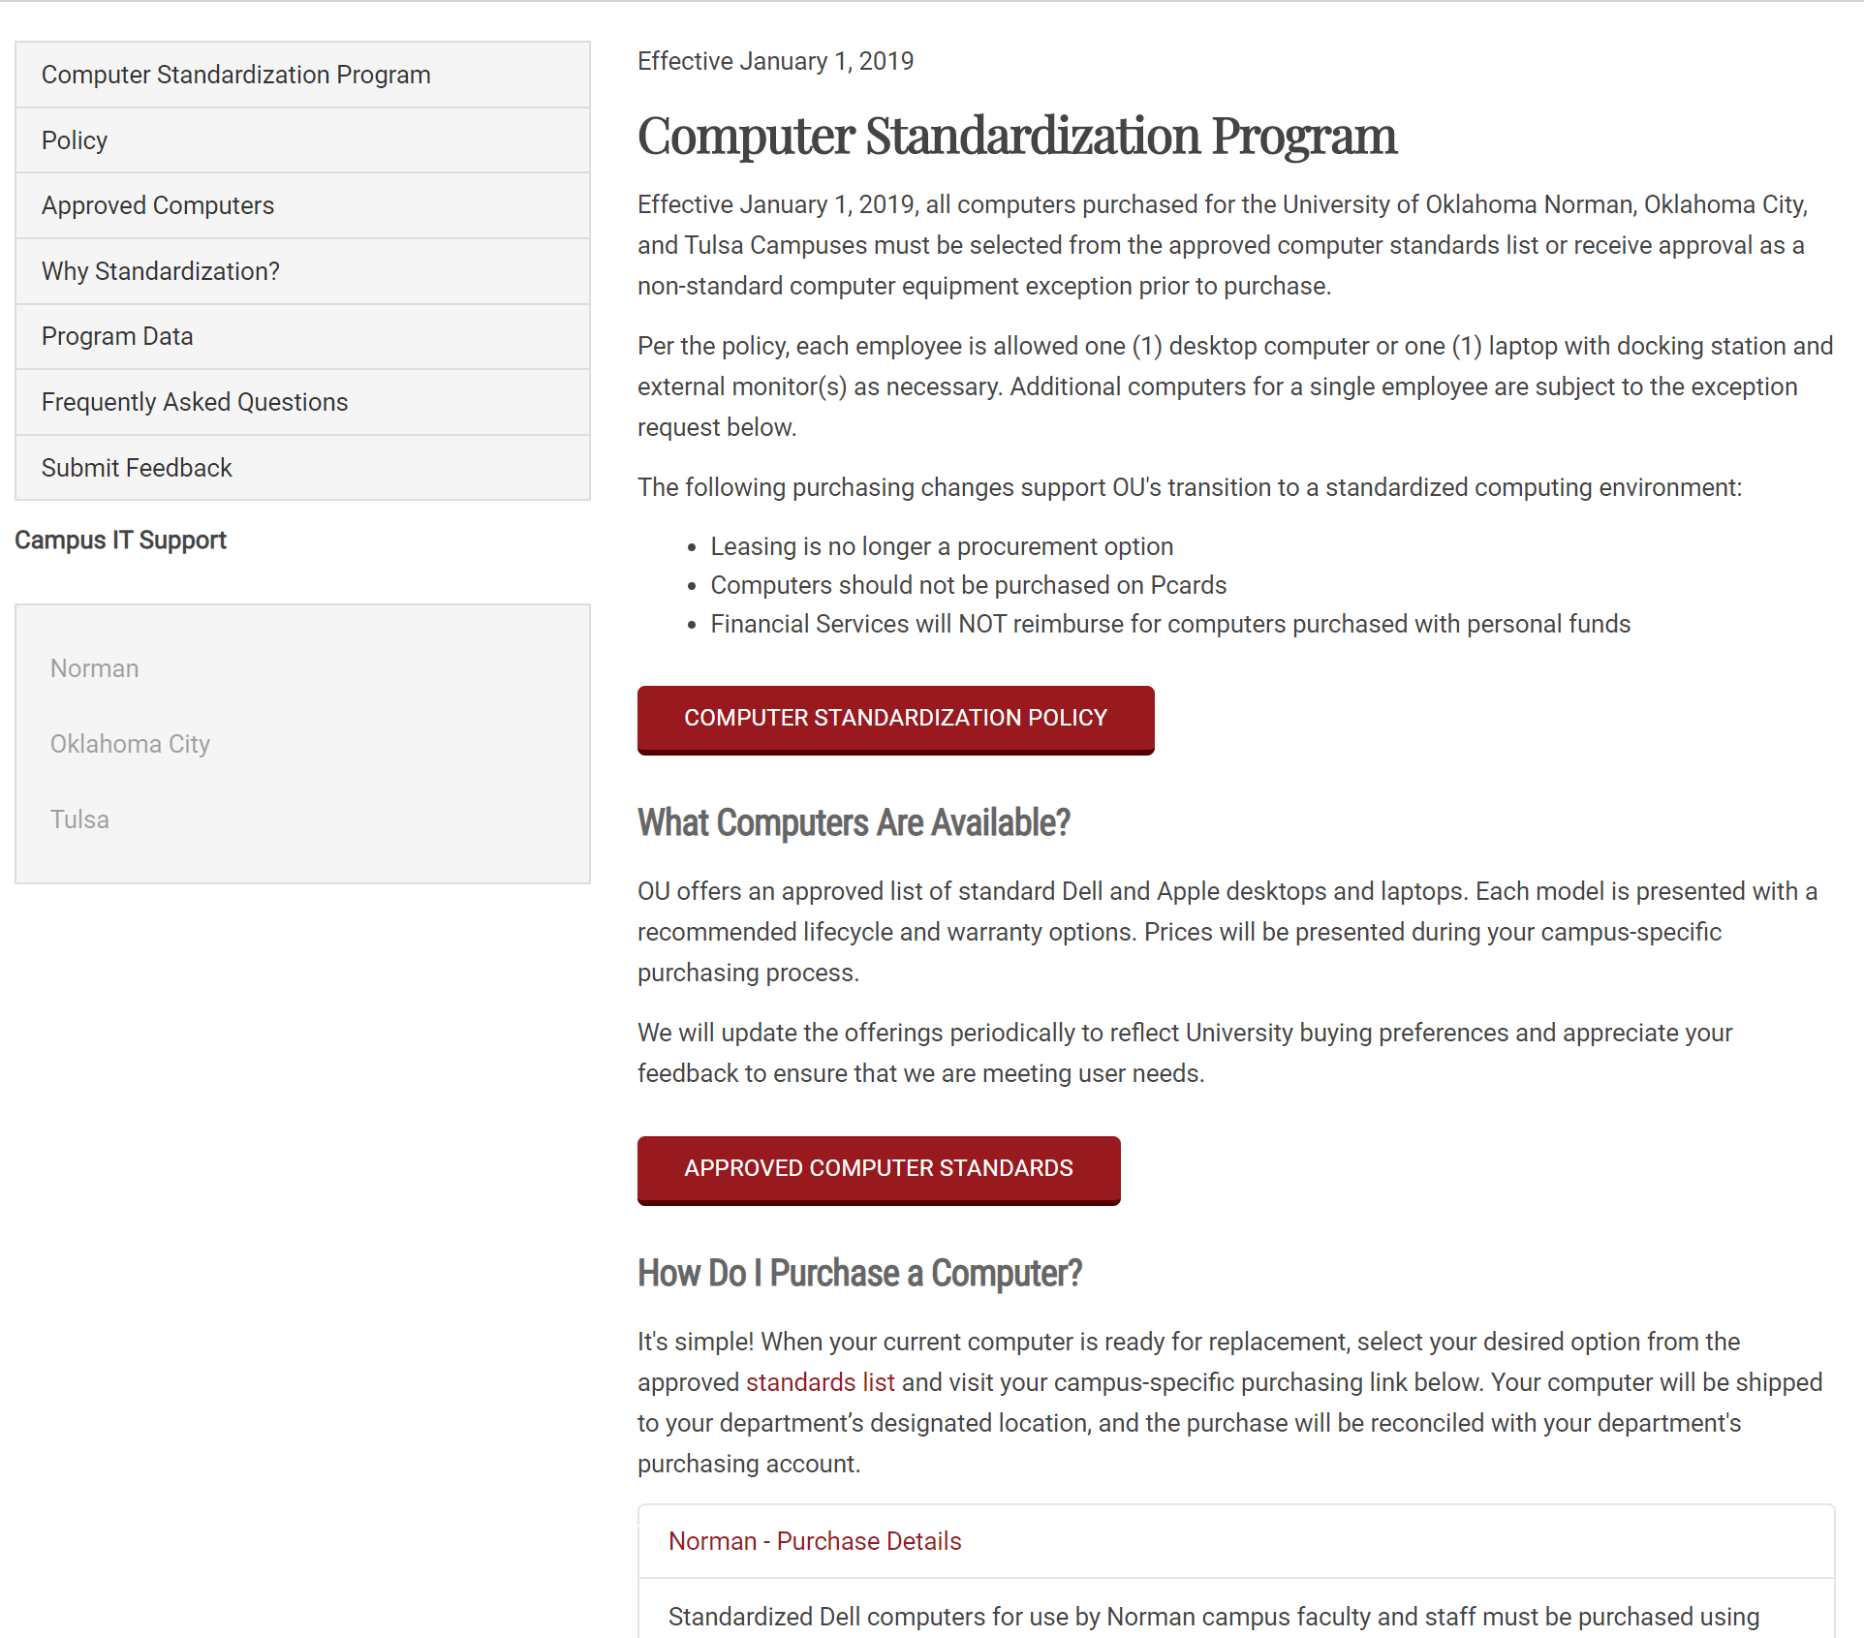
Research From Other Universities
University of Oklahoma

Slide 10
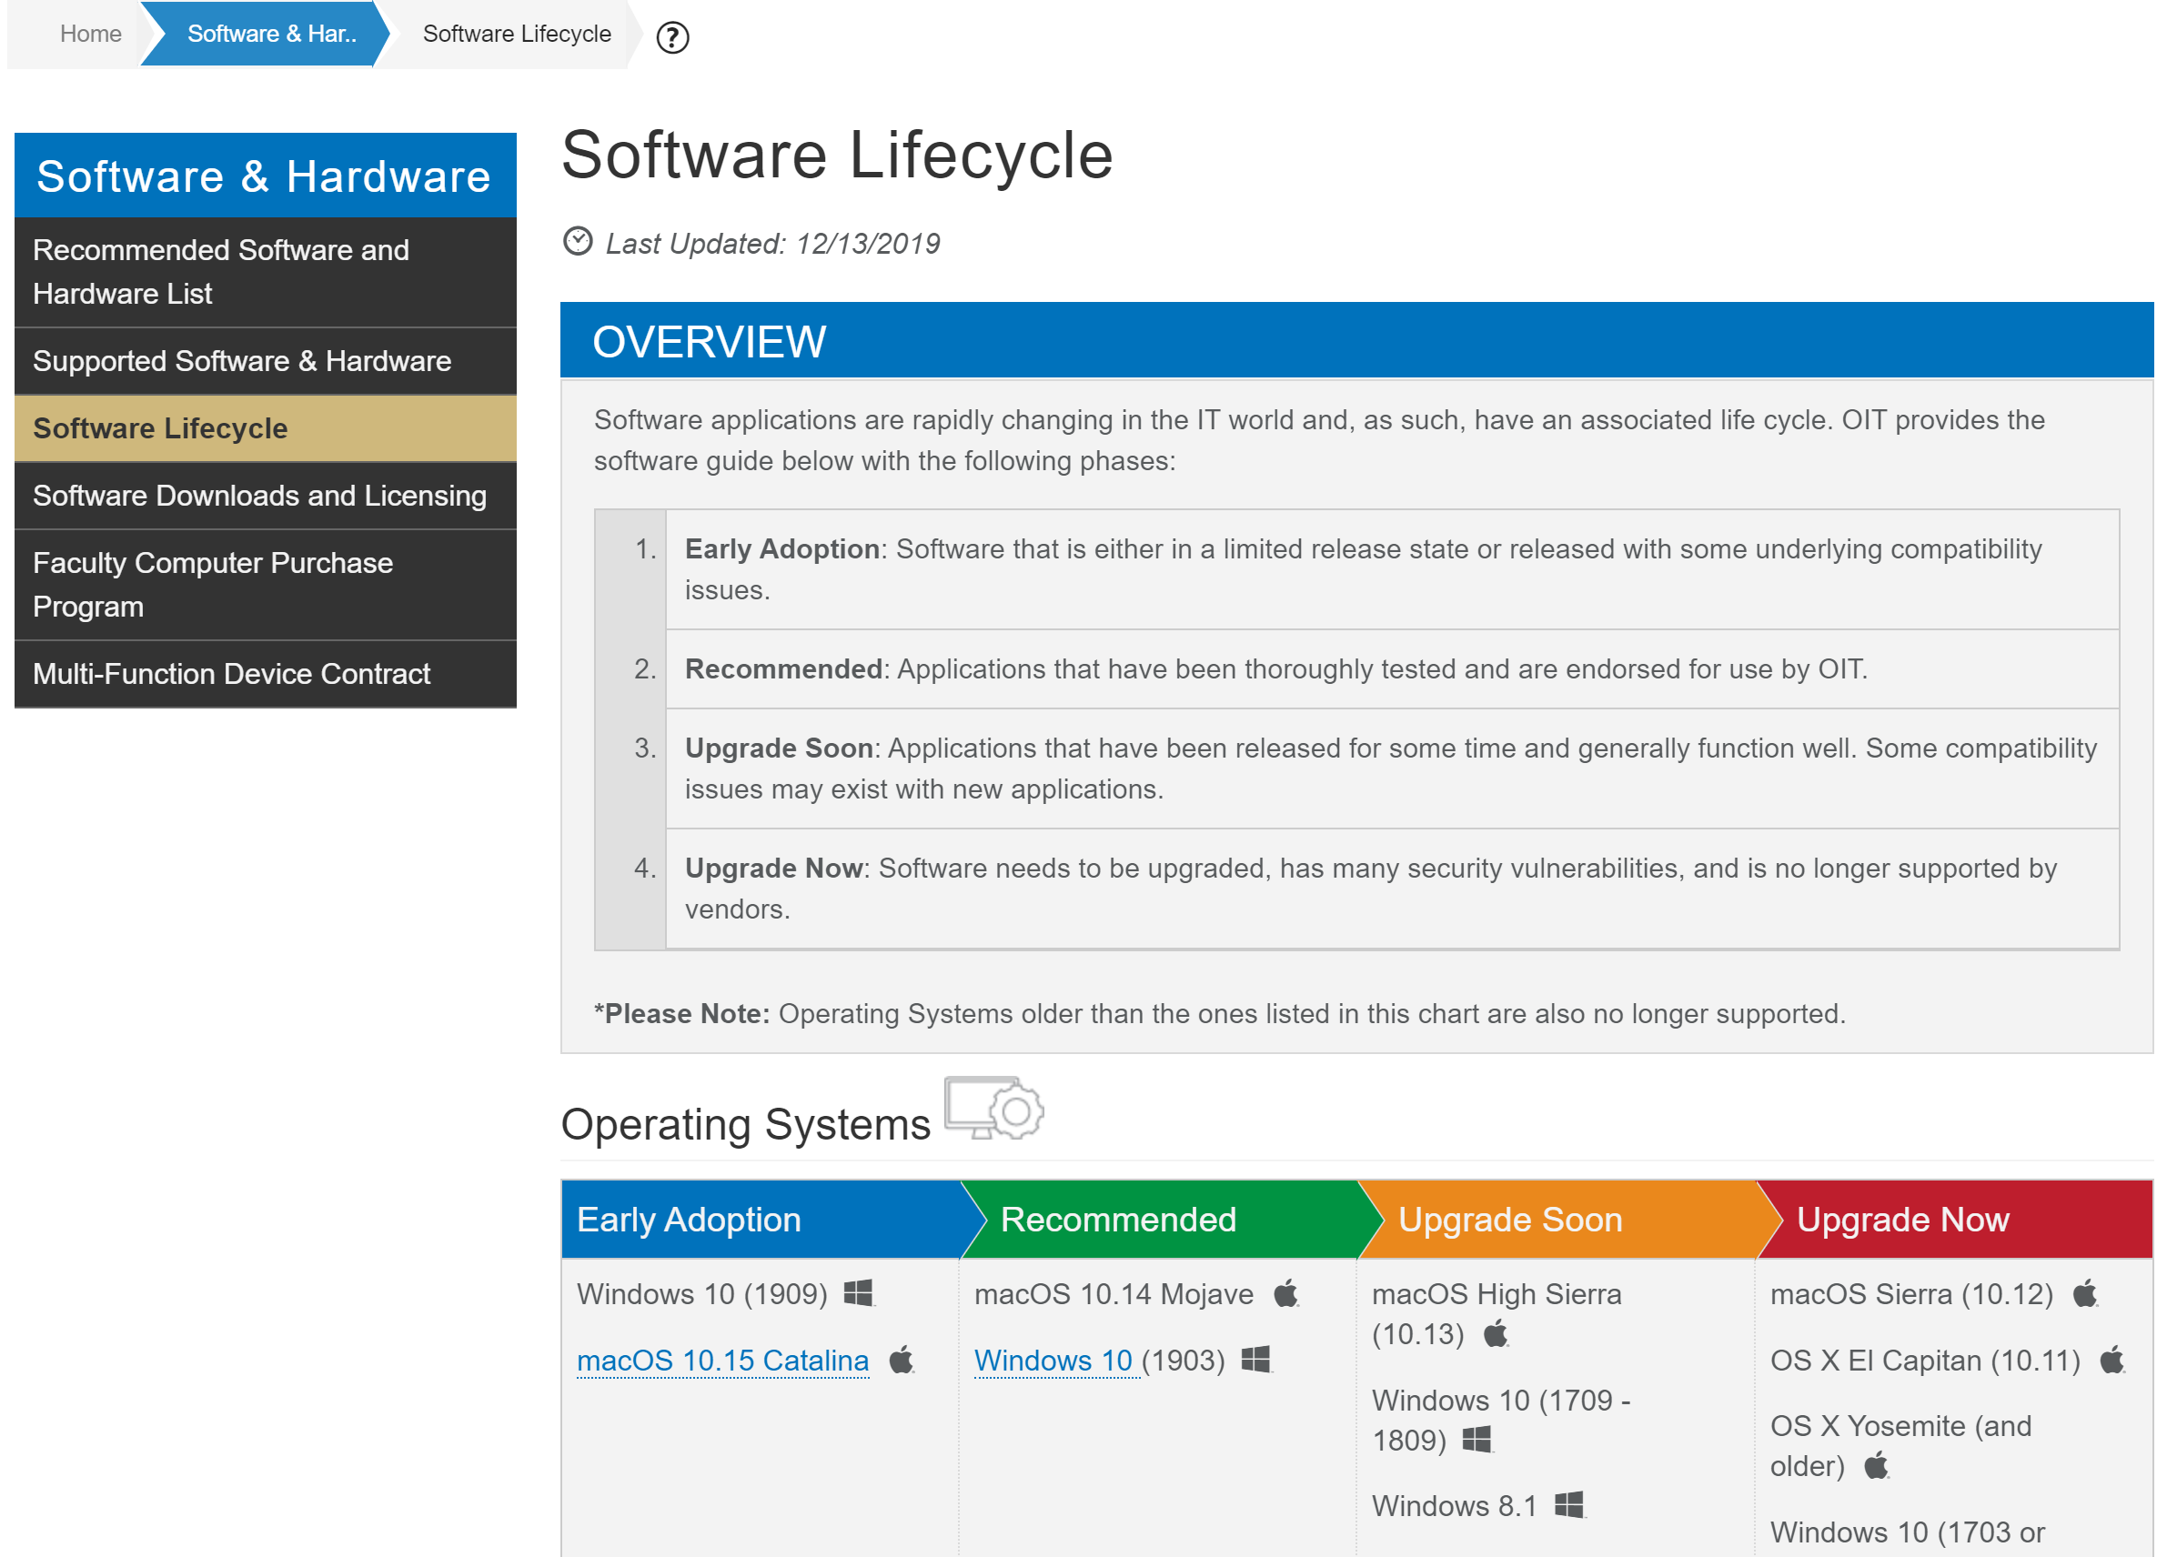
Research From Other Universities
University of Boulder Colorado

Slide 11
Early Goals
Spoke high level on areas we can bring into a standardization.
    Desktops, Workstations, Laptops, Tablets, Docks, and Displays
    Printers, MFC, & Peripherals
    Smartphones (University Owned)
    AV Equipment, Projectors, & Signage

Slide 12
The Groups
Set leaders into each group to setup meeting times and manage meetings.
  Several people, myself included were in multiple groups.
The initial proposal needed to be complete by end of 2019
  First draft was due Nov. 12
  Standards and Framework

Slide 13
Desktops, Laptops, Workstations, Tablets Docks, Displays
Review of scope
Vendors
  Dell
  Apple
Specialized equipment
  Local IT

Slide 14
Desktops, Laptops, Workstations, Tablets Docks, Displays
Purchasing
  CyBuy
    Dell
    CDW
Banning of Asset Recovery

Slide 15
Printers, MFC, & Peripherals
Brands – HP, Toshiba
Purchasing
  CDW-G
    IBOR Standards
  Toshiba
    MFC
    Contract

Slide 16
Printers, MFC, & Peripherals
Extended warranties
Color vs B&W
Networked
Print release stations (MFC)
Lifecycle
Scanners

Slide 17
Printers, MFC, & Peripherals
Type | Printer | Model | Cost | Care Pack
B&W | LaserJet Pro M404dn Printer B&W | W1A53A | $197.00 | $126.40
 | LaserJet M501dn Printer B&W | J8H61A | $499.00 | $138.40
 | LaserJet M608dn Printer B&W | K0Q18A | $1,100.00 | $249.12
Color | Color LaserJet Pro M454dn | W1Y44A | $269.10 | $154.08
 | Color LaserJet M553dn | B5L25A | $616.00 | $212.21
MFP | B/W LaserJet Pro MFP M428fdn | W1A29A | $305.38 | $217.75
 | Color LaserJet MFP M479fdn | W1A79A | $392.88 | $236.20
Personal | LaserJet Pro M203dw B&W | G3Q47A | $115.00 | $36.90

Slide 18
University Owned Smartphones
How many on campus?
Smart vs dumb
Should devices be managed?
  iPhone - Jamf/DEP
  Android - Intune

Slide 19
University Owned Smartphones
Contract Effective after 9/30/16 | Verizon | US Cellular | Total
iPhone | 193 | 62 | 255
iPad | 98 | 3 | 101
Watch | 1 | 0 | 1
Android Phone | 68 | 30 | 98
Dell or Android Tablet | 16 | 0 | 16
Total | 376 | 95 | 471
Facilities Planning and Management not accounted for estimated 350 Android devices

Slide 20
AV Equipment, Projectors, & Signage
Created a minimum standard
Quick all-in-one solution
Trying to match standards campus standard
Flat panel displays
  Samsung Professional/Commercial

Slide 21


Thank You
Contact information:
  Barrett Ford
  Bford@iastate.edu

